Slide 1
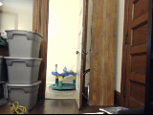
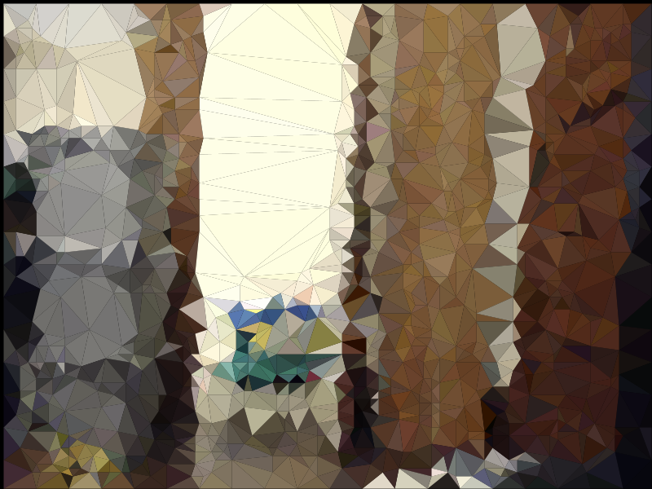
Real-Time Vector Geometry Based Video Compression for Low-Latency Teleoperation over Low-Bandwidth Connections
Curtis Boirum
F-13 Computer Vision
5/8/2013
Notes:
Replace with images from mars rover and/or statue of liberty flyby true vs encoded.

Slide 2
“fpv” = “Consumer” Teleoperation
Remote driving or flying an RC vehicle (drone) through wireless onboard video feed
Thrill/enjoyment/videography very similar to full sized vehicle for orders of magnitude cheaper
Enabling immediate disaster investigation, search & rescue, real-time information that was previously impossible/impractical

Slide 3
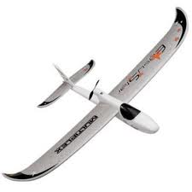
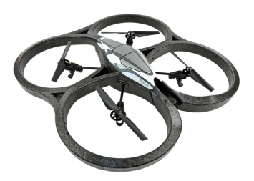
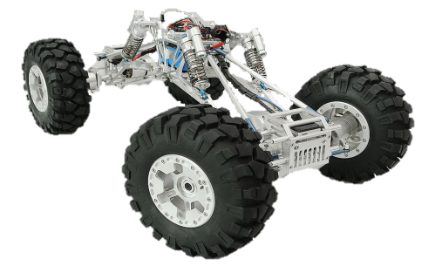
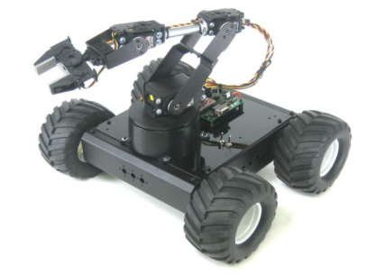
No Longer Limited To Military Domain
Consumer Autonomous UAV/UGV’s $200-$2000 common
Light Weight, Miniature, and Inexpensive
High precision sensors
GPS, Gyroscopic, Accelerometers, Ultrasound, LiDAR
Most have >= 100Hz sample rates
Cameras (Digital and Analog)
Small form factor computers and microcontrollers
Intel Nuc, Raspberry Pi, Arduino, etc.

Slide 4

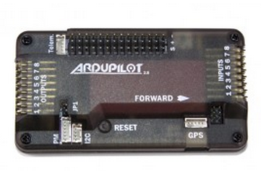
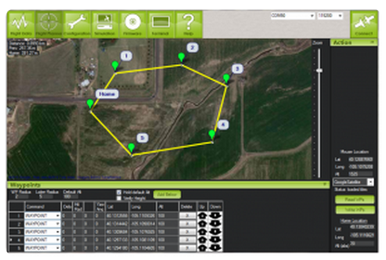
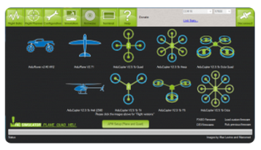

Explosion in UAV and UGV Operation
Hobbyist
Venders
Open source projects
Fierce market competition driving down prices
Professional (Non-military)
Law enforcement
Real estate
Agriculture
Environmental monitoring/conservation
Search and rescue
Research

Slide 5
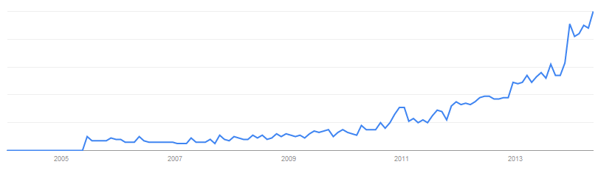
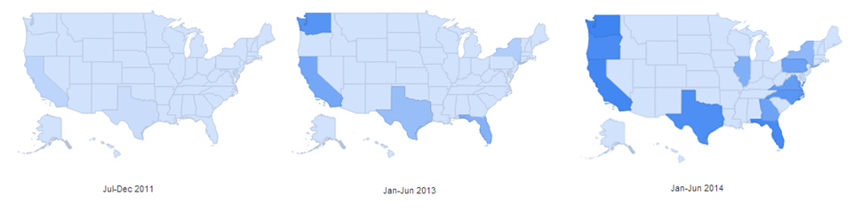
“fpv” Relative Google Trends
End of 2011
End of 2013
Beginning of 2014
"Data Source: Google Trends (www.google.com/trends)."

Slide 6
A Problem Remains…
Everything is in place except: Real-Time wireless video transmission
Many low-bandwidth devices are perfect form factor and price
But they cannot transfer data fast enough to support a useful video
(max rate <<1Mb/s)
Notes:
Available short range solutions ~100m
WiFi based
2.4/5.8GHz “Security Cameras”
Long range solutions ~1Km
~200mW analog transmitters
Very noisy and limited to SD TV resolution
May require HAM radio license
Cellular Based (4G)
Most existing systems have conflicting design goals
Quality at expense of frame rate
Lag induced by compression/decompression
Designed for smooth playback, not necessarily responsive playback
Network transport delays and uncertainties
Current “Gold Standard”
Teleoperation by low quality analog camera and transmitter
Onboard recording of a high quality digital camera (GoPro)

Slide 7
Computer Vision Solution
Enable use of existing (and prolific) technologies assuming:
An operator is (primarily) interested in
Understanding the remote environment dynamically
How it responds to the robot
How robot responds to it
Quickly know consequences of commands
Update commands multiple times/second
Building a mental model of environment
For navigation
For manipulation
For survelance

Slide 8
Reduce Dimensionality
Assume only subset of image data is needed
Corners
Edges
Areas of high contrast
Areas of high detail
Watching objects move = operator can build intuitive environmental model
Sounds like Structure From Motion!

Slide 9
Concept
Detect corners and edges quickly
FAST features find consistent corners extremely fast
Hough transform finds straight lines extremely slowly
Attempt to connect FAST features with line segments in a quicker way:
Delaunay Triangulation (very fast)
Imperfect segmentation, but SOME triangle edges WILL align with real word geometry edges

Slide 10
Algorithm
Find features (limited to M features)
Psuedo-segment the image with Delaunay Triangulation
Color each triangle based on its center (crude method)
Image is now only a list of colored vertices groups

Slide 11
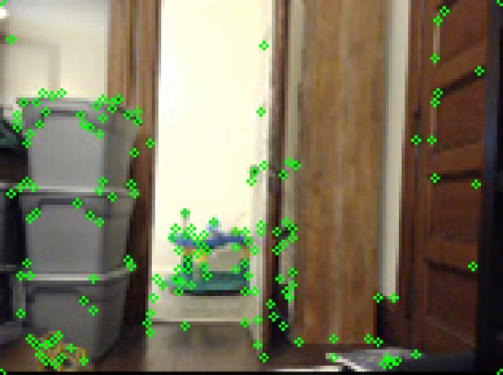

Algorithm: 1 Find Features

Slide 12
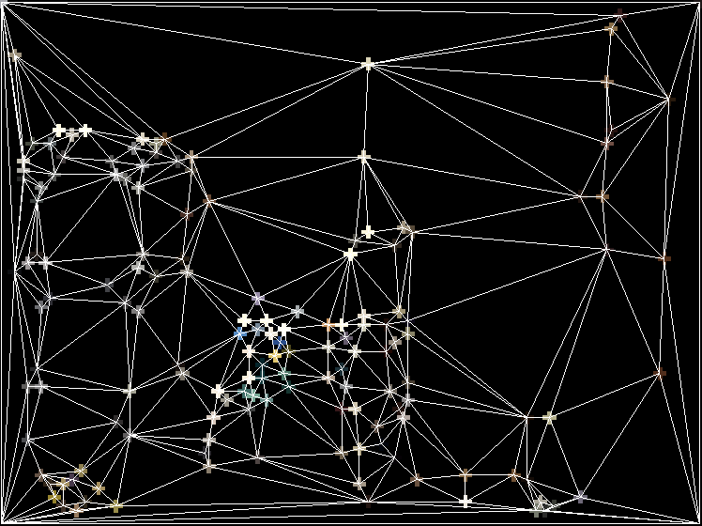
Algorithm: 2 Pseudo Segmentation

Slide 13
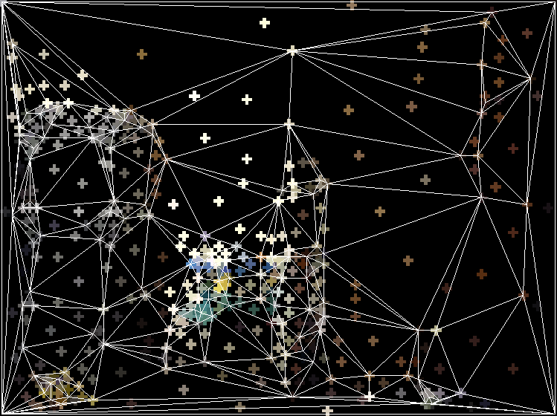
Algorithm: 3 Triangle Color

Slide 14
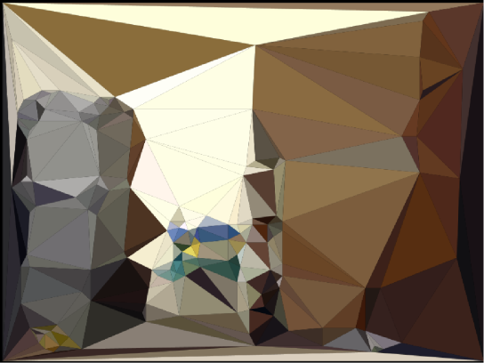
Algorithm: 4 Encode/Render

Slide 15
Find Features
Following Attempted:
Harris
FAST
SIRF
MinEig
Hough Transform
Only FAST was fast enough

Slide 16
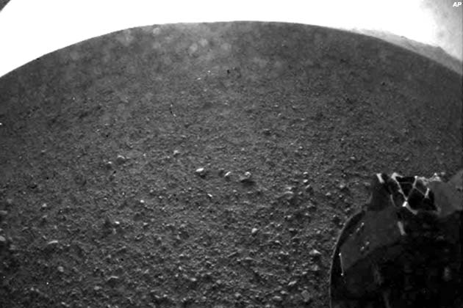
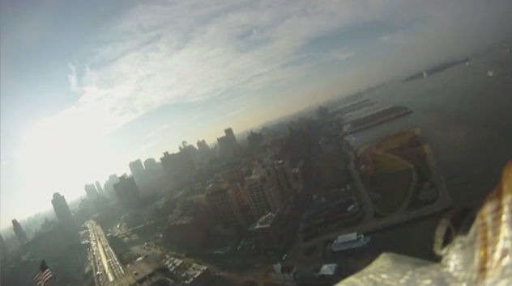
Feature Detection Comparison
630 x 420 pixels
1627 x 910 pixels

Slide 17

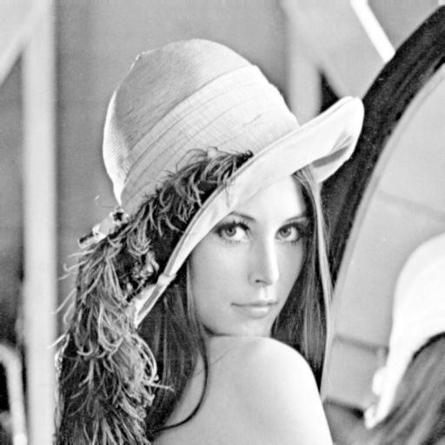

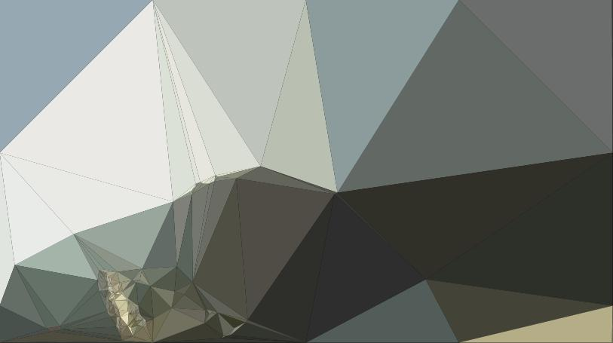
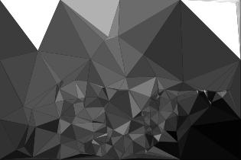
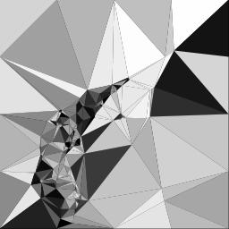
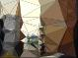
Results: Compression Time
Compression Limited to 316 Triangles

Slide 18
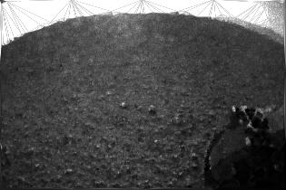
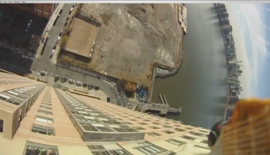
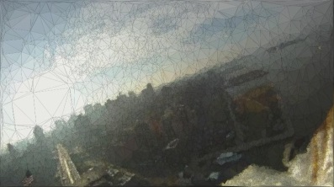
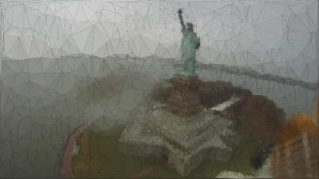
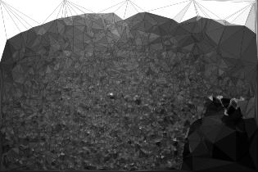
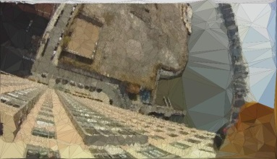
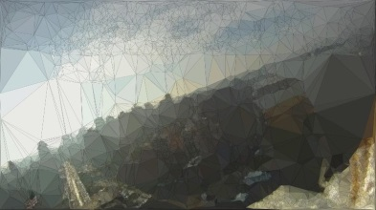
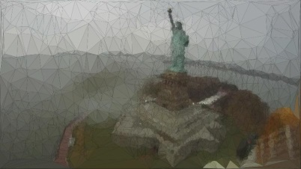
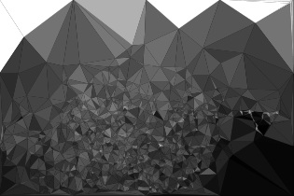

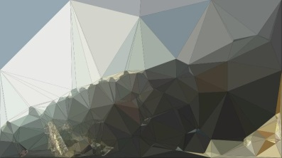
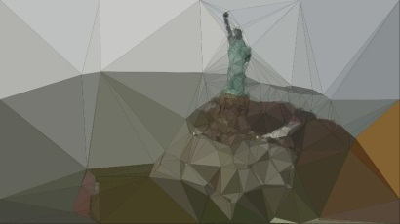
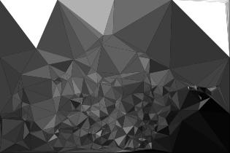
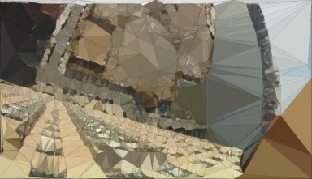
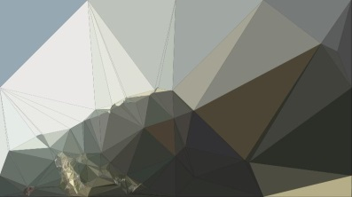
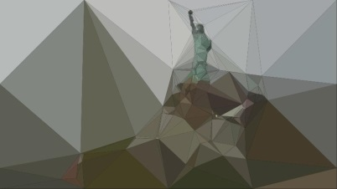
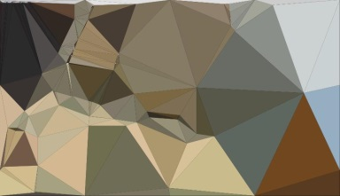

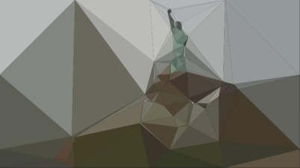
Results: Compression Ranges
235 | 22526
102 | 9104
18 | 1832
7 | 620
4 | 316
Original Size KB
280
1329
1470
716
Compressed Size KB
# of Triangles

Slide 19
Improvements
Graph-search/thresholding on triangle color to reduce number of separate triangles into polygons
Feature density control
Feature noise reduction
Combine line segments that are nearly collinear (on polygons)

Slide 20

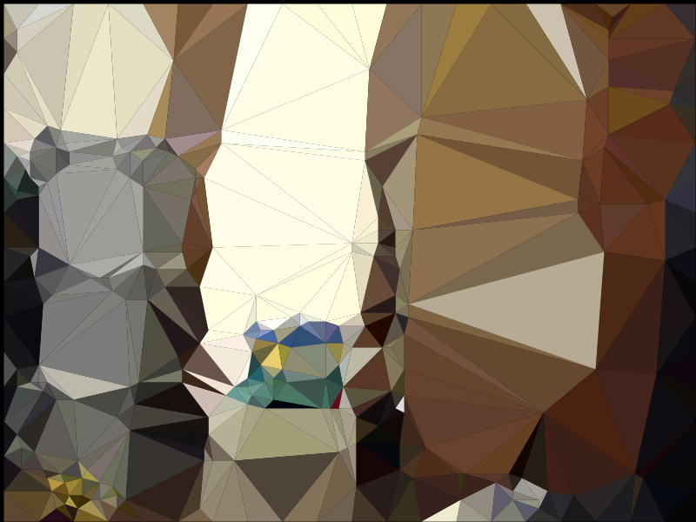
Conclusion
Even unoptimzed show great potential
Image size is very close to a .jpg for 160 x 120
Drastic gains for large images > 1280 x 720
Optimization could render outputs capable of being streamed over very inexpensive serial radios ~ 200Kbits/sec
Interesting type of segmentation
Many avenues could prove fruitful

